Slide 1
Recommendation System
Zining Wang, Jiayu Yao, Qiyang Li

Slide 2
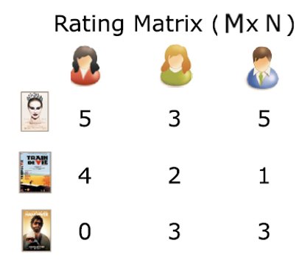
Recommendation System
Dataset:
User, Movie → Rating(1-5)
1 M dataset by Grouplens
User id, movie id, ratings
Additional user, movie information
Methods:
K Nearest Neighbor (KNN)
Singular Vector Decomposition (SVD)
Random Forest
Hybrid Recommendation System Methodology
Novel ideas..
?
Zining Wang, Jiayu Yao, Qiyang Li

Slide 3
Baseline: SVD
SVD:
k = numbers of eigen values we take
test RMSE = 0.9626
Zining Wang, Jiayu Yao, Qiyang Li

